Slide 1
Digital Portfolio
STUDENT NAME:ELAVARASI R
REGISTER NO AND NMID: 24131040500122007 and E8568F1FACC7030A74548F9368A1F016
DEPARTMENT: B.C.A
COLLEGE: JAWAHAR ARTS AND SCIENCE COLLEGE/
ANNAMALI UNIVERSITY

Slide 2

PROJECT TITLE
DIGITAL PORTFOLIO

Slide 3


AGENDA
Problem Statement
Project Overview
End Users
Tools and Technologies
Portfolio design and Layout
Features and Functionality
Results and Screenshots
Conclusion
Github Link
3/21/2024 Annual Review

Slide 4

PROBLEM STATEMENT
IN TODAY’S GENERATION ERA,TRADITIONAL RESUME ALONE ARE NOT ENOUGH TO SHOW YOUR SKILLS AND WORK
4

Slide 5

PROJECT OVERVIEW
BRIEF SUMMARY OF MY PROJECT AND MY WORK
MY PORTOFOLIO CONTAINS (ABOUT ME, SKILLS AND WORK MAIN THEME: SHOWCASE OF MY WORK

Slide 6

WHO ARE THE END USERS?
STUDENTS (RESUMES, ACADAMIC PROJECT)
JOBSEEKERS (TO SHARE WITH RECRUITERS
FREELENCERS (TO SHOW CLIENTS)

Slide 7

TOOLS AND TECHNIQUES
HTML: STRUCTURE (PAGES , SECTIONS)
CSS: STYLING (COLORS,LAYOUT)
JAVASCRIPT: INTERACTIVE ( MEANU BAR , VALIDATION)
CODE EDITOR → (VS CODE)
HOSTING PLATFORM → ( GITHUB PAGES)

Slide 8
POTFOLIO DESIGN AND LAYOUT
SECTION
HOME
PROJECTS
SKILLS
CONTACT

Slide 9
FEATURES AND FUNCTIONALITY
NAVIGATION BAR WITH (SMOOTH SCROOLING)
IMAGE DETAILS/ HYPER LINK
INTERACTIVE ELEMENT

Slide 10
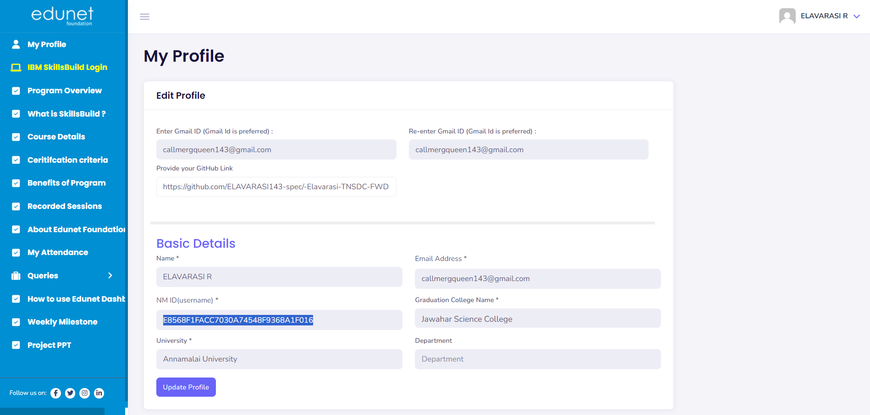

RESULTS AND SCREENSHOTS
3/21/2024 Annual Review

Slide 11
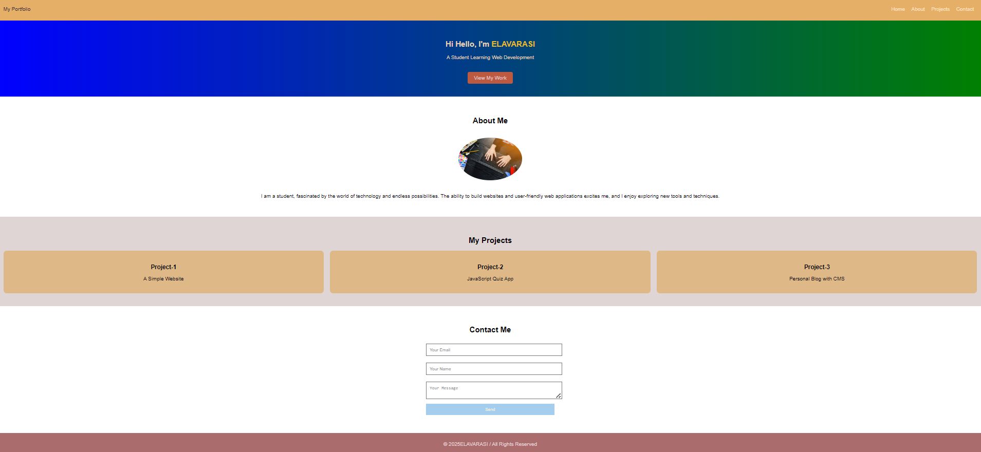
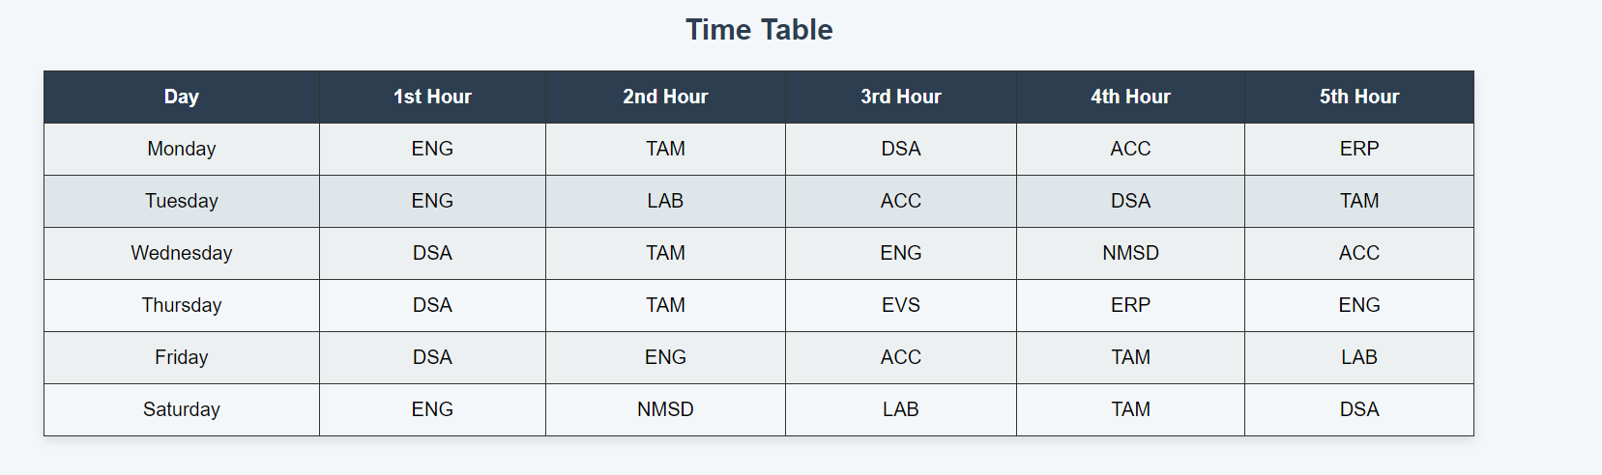
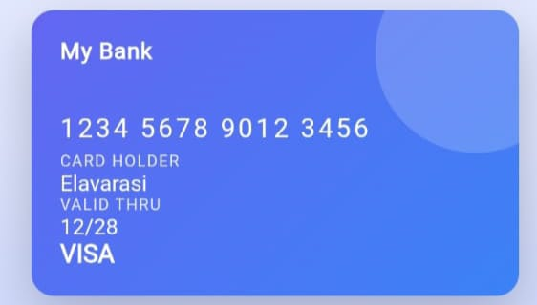

Slide 12
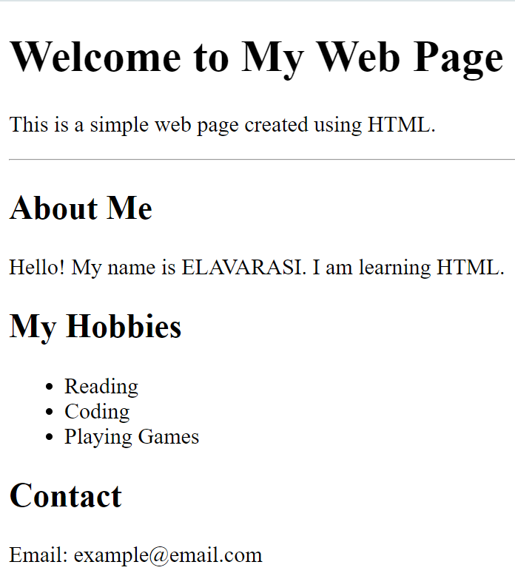

Slide 13
CONCLUSION
ENJOY LEARNING…

